Slide 1
PGVCL Training
Day-2

Slide 2
Flutter Training for PGVCL Department
Day 2: Theming and Styling

Slide 3
Overview
Topics We’ll Be Covering For Today
Practical & Assignment
Apply light and dark themes to an app
Customize buttons, text fields, and other components
Assignment:
Create a styled app with consistent theming for a login page
Theory
Understanding Flutter themes
Styling components using themes.

Slide 4
Introduction to Flutter Themes-
Styling Components Made Easy
Understand the role of themes in Flutter.
It allows building compile natively apps for mobile, web, and desktop from a single codebase.
Uses Dart programming language for fast and efficient development.
Hot Reload feature enables faster development cycles.

Slide 5
What is a Theme?
A theme is a collection of styling parameters like colors, text styles, and shape specifications.
Purpose of Theme:
Maintain consistency in app design.
Simplify UI customization.
Reduce repetitive code.
Key Classes:
ThemeData : Defines overall app styles
TextTheme : Handles typography styles

Slide 6
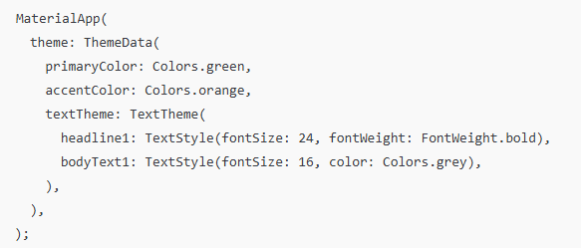
Setting a Global Theme :

Slide 7
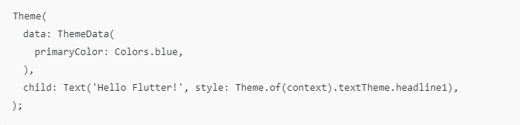
Applying Local theme :

Slide 8
Styling Components Using Themes
Accessing Theme Data:
Theme.of(context) to retrieve the current theme.
Customizing Widgets:
Container( color: Theme.of(context).primaryColor, child: Text('Styled with Theme'), );
Dynamic Theming:
Use Brightness.light and Brightness.dark for light/dark mode toggles.

Slide 9
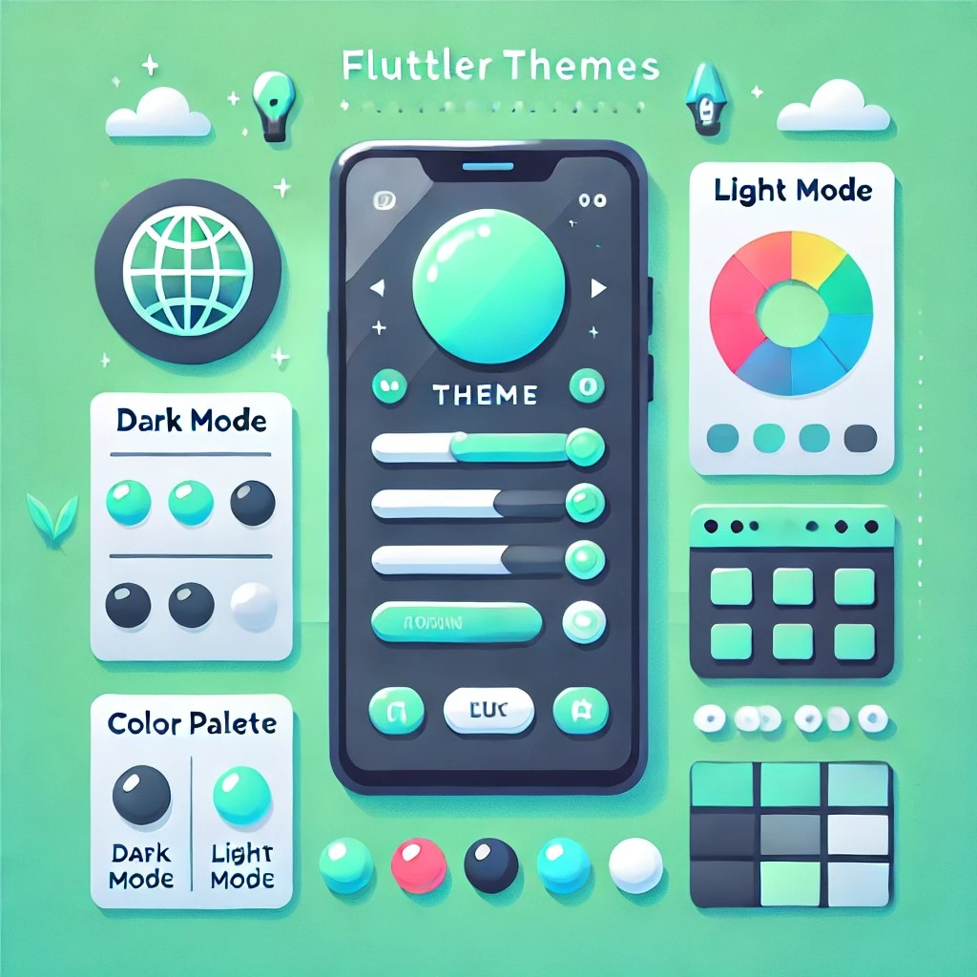

Slide 10
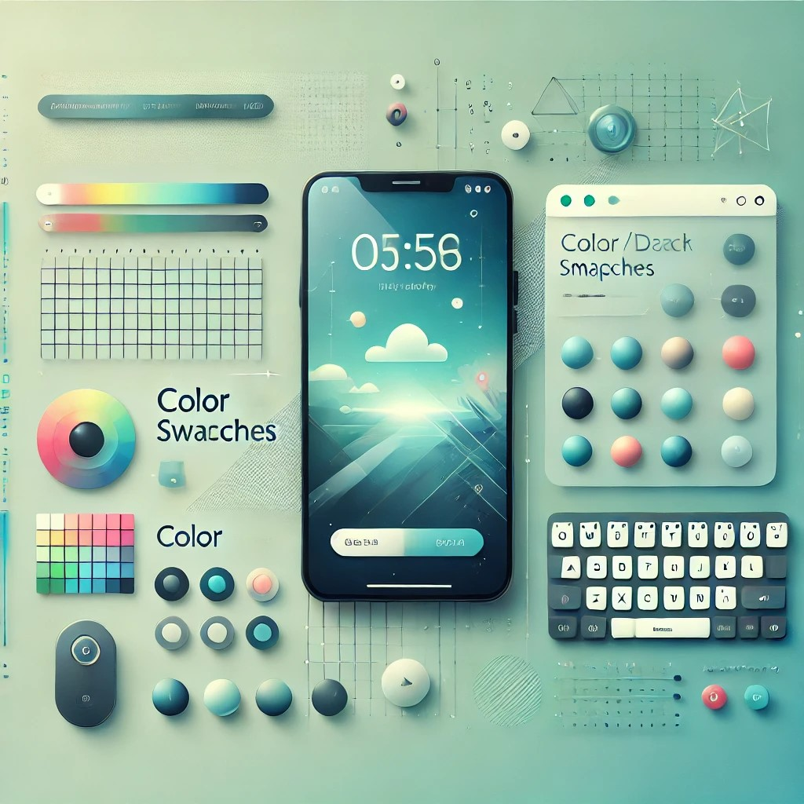

Slide 11
Practical Example
Link
Assignment Example
Create a basic UI with 3 Stateless Widgets and 2 Stateful Widgets

